Slide 1

DNA Matching Simulator
Group Members :-
Hamna khan (SP-23856)
Nimra Nisab (SP-23869)
Aniqa Jamil (SP-23868)
Rania Nisar (SP-233891)
Jahanzaib (SP-23870)
Zulqarnain Haider (SP-23859)

Slide 2
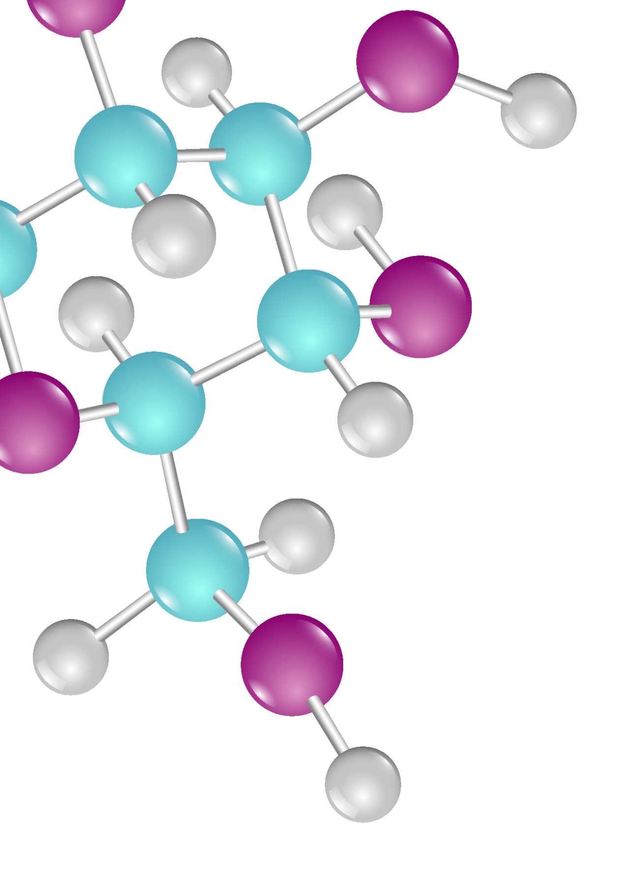
INTRODUCTION
This project introduces GeneLink , a C++ console application designed to analyze genetic relationships, detect mutations, and trace ancestral connections using the Levenshtein Distance Algorithm.

Slide 3
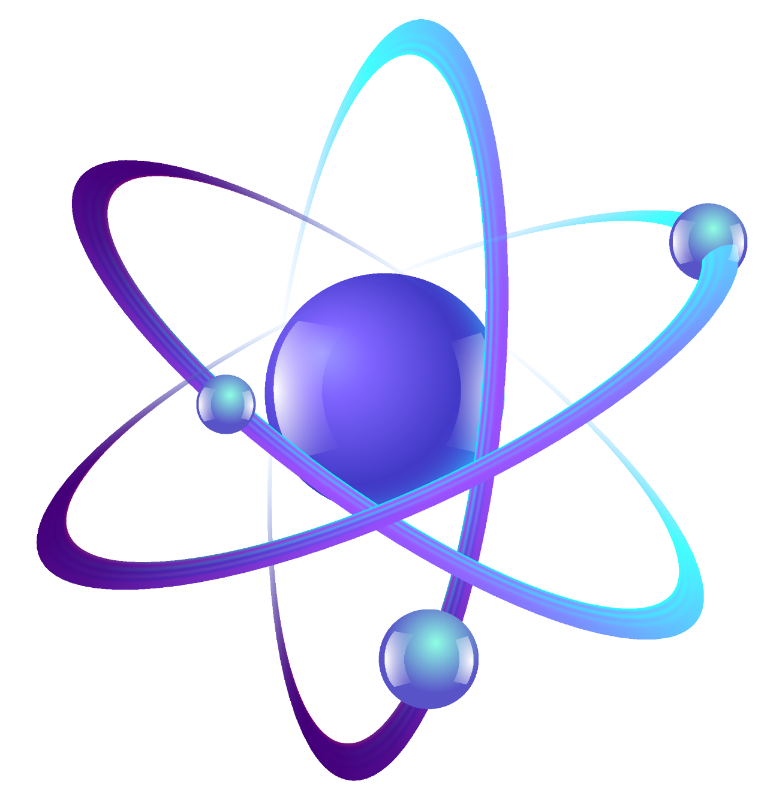
PROJECT OVERVIEW
Core Functionality
Applications
Technology
uses Levenshtein Distance to measure minimal edits between DNA sequences, providing a similarity score.
Identifies familial links, traces mutations, and detects ancestral genes by comparing DNA sequences.
Implemented as a C++ console app with dynamic programming for efficient sequence comparison.

Slide 4

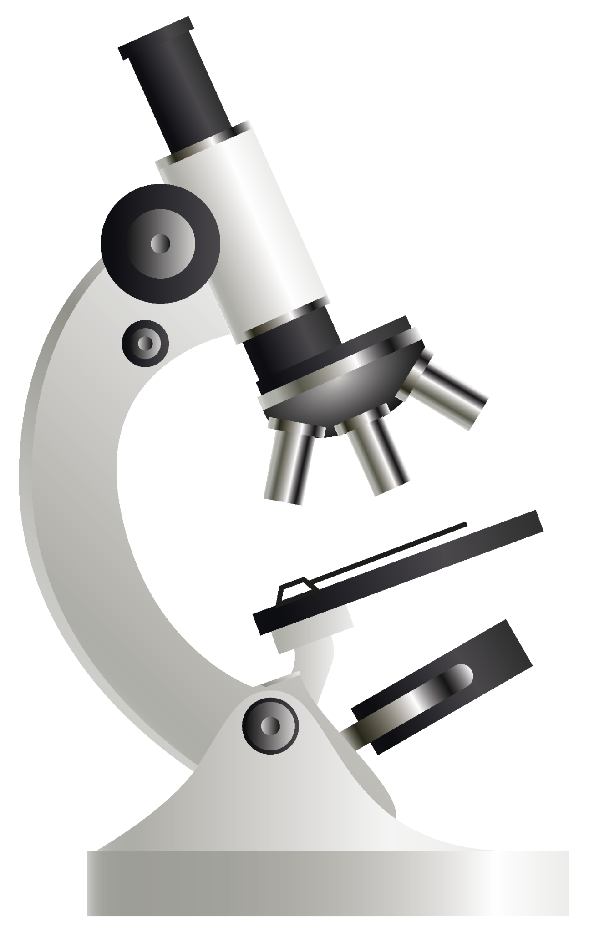
Problem Statement
Challenges
Goals
Traditional methods struggle to efficiently capture minimal evolutionary or mutational differences in DNA.
Design a system to accurately compute genetic similarity, detect mutations, and trace ancestral genes.
Key Issues
Efficient Levenshtein algorithm for long sequences
Minimizing false positives in comparisons
Scalable for large genomic datasets
User-friendly interface for researchers

Slide 5
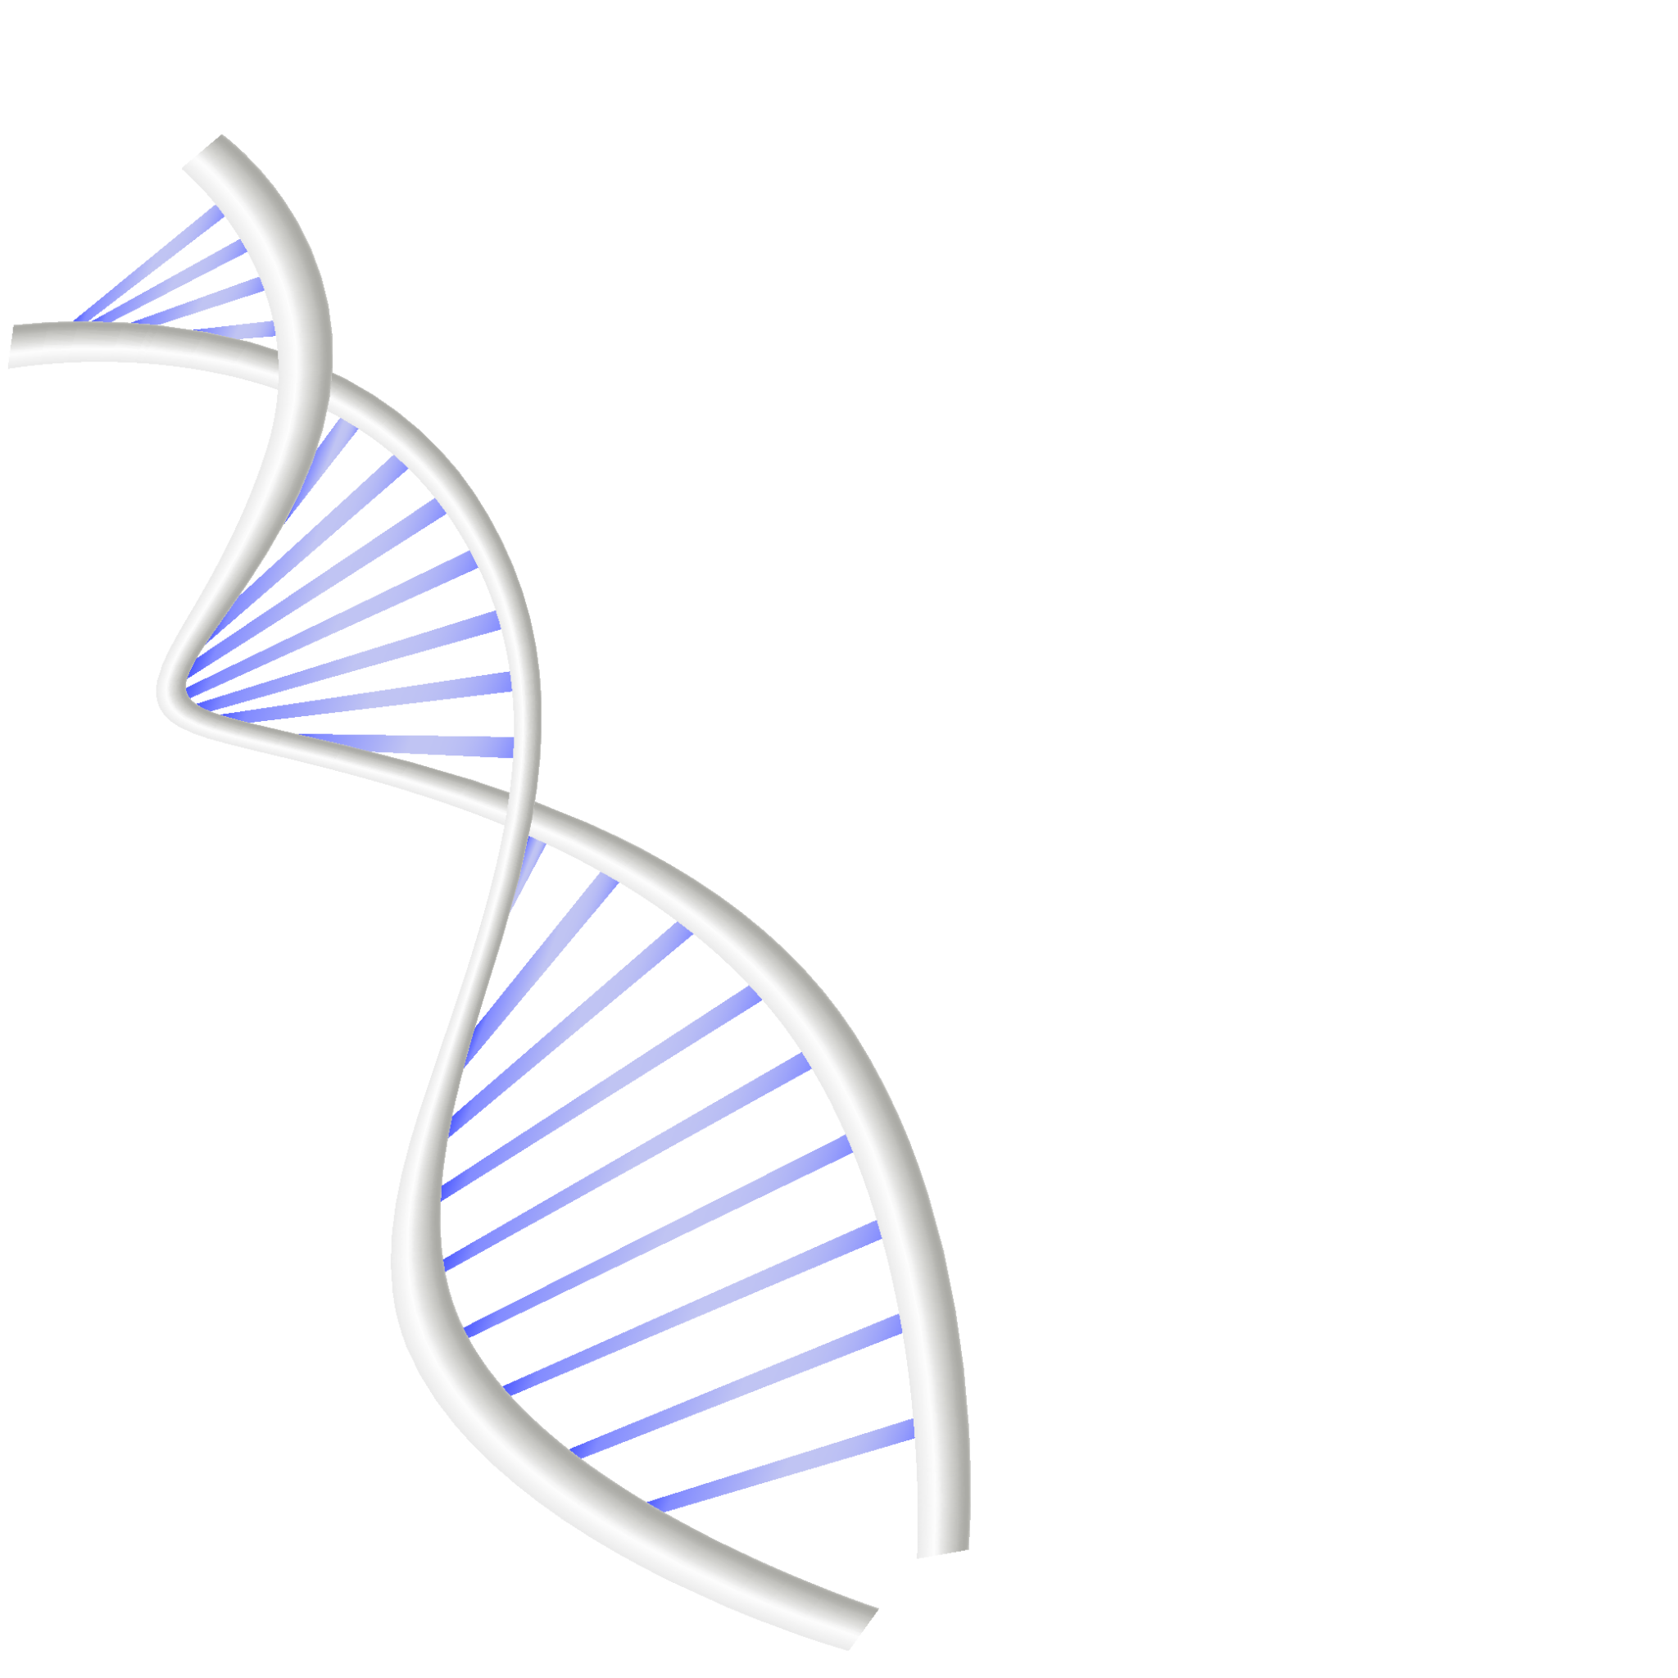
Project Analysis: Modules
Module 1: DNA Similarity Comparison
Manual pairwise or single-vs-all comparisons using map data structures and color-coded visual alignments.

Slide 6
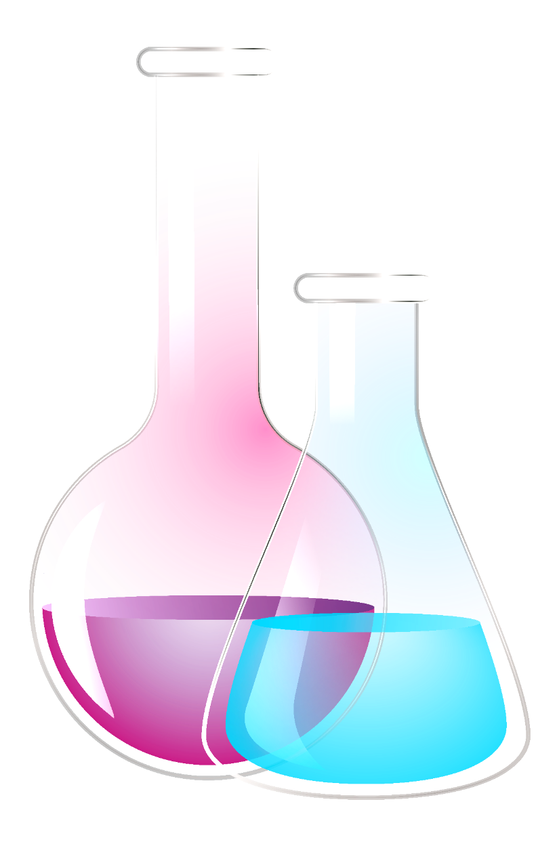
Module 2: Ancestral Gene Detection
Module 3: Mutation Detection (Planned)
File-based matching against ancestral DNA records with sorted similarity scores and visual highlights.
Traceback on Levenshtein matrix to identify substitutions, insertions, and deletions with detailed reports.

Slide 7
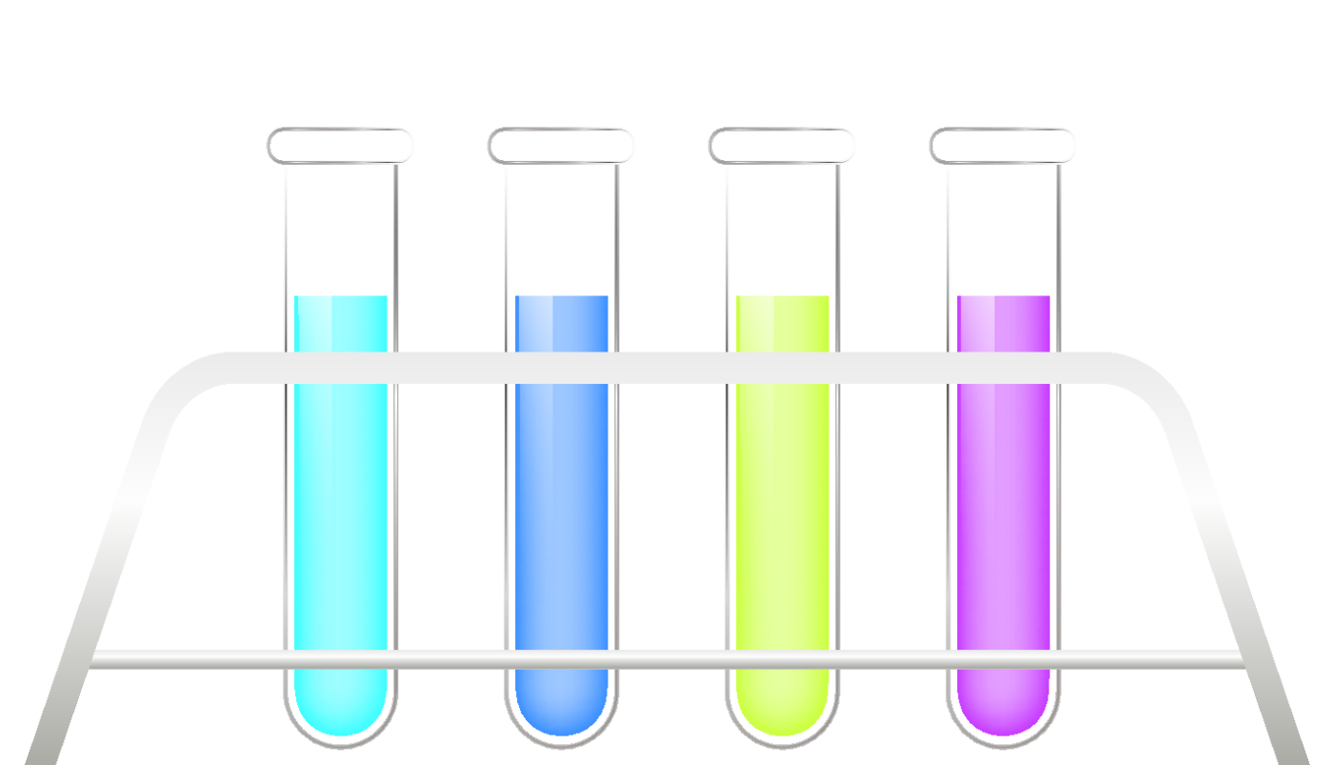
Technical Highlights
Algorithms
Data Structures
Uses map for DNA profiles, 2D vectors for dynamic programming matrix, and pairs for similarity scoring.
Leverages Levenshtein Distance for insert, delete, and substitute operations in DNA sequence comparison.
User Interface
Command-line interface with ANSI colors, progress bars, and clear visual alignments for usability.

Slide 8
DNA Similarity Comparison Algorithm
Initialization
Create DP table with base cases for insertions and deletions.
1
Computation
Fill table comparing characters; match copies diagonal value, mismatch adds minimum edit cost.
2
Similarity Calculation
Calculate similarity as 100 minus normalized edit distance percentage.
3
Output
Display colored alignment showing matches and mismatches visually.
4

Slide 9
Ancestral Gene Detection Algorithm
Data Input
Read and parse ancestral DNA records from files, ignoring malformed lines.
Similarity Scoring
Compute Levenshtein distance between user DNA and each ancestral record.
Sorting & Display
Sort results by similarity score and highlight top matches with visual alignments.

Slide 10

Mutation Detection Algorithm (Planned)
Mutation Types
Traceback Process
Substitutions (e.g., A to G)
Trace path from DP matrix end to start to identify mutation types.
Insertions (e.g., +T)
Deletions (e.g., –C)
Reporting
Generate detailed mutation reports with location, type, and involved characters.

Slide 11
Conclusion and Impact
Educational Value
Functional System
Combines data structures and algorithms with practical genetic analysis for learning and research.
Accurately detects genetic similarity and explores evolutionary connections using C++ modules.
Future Potential
Foundation for mutation detection tools and bridging computer science with biological research.

Slide 12
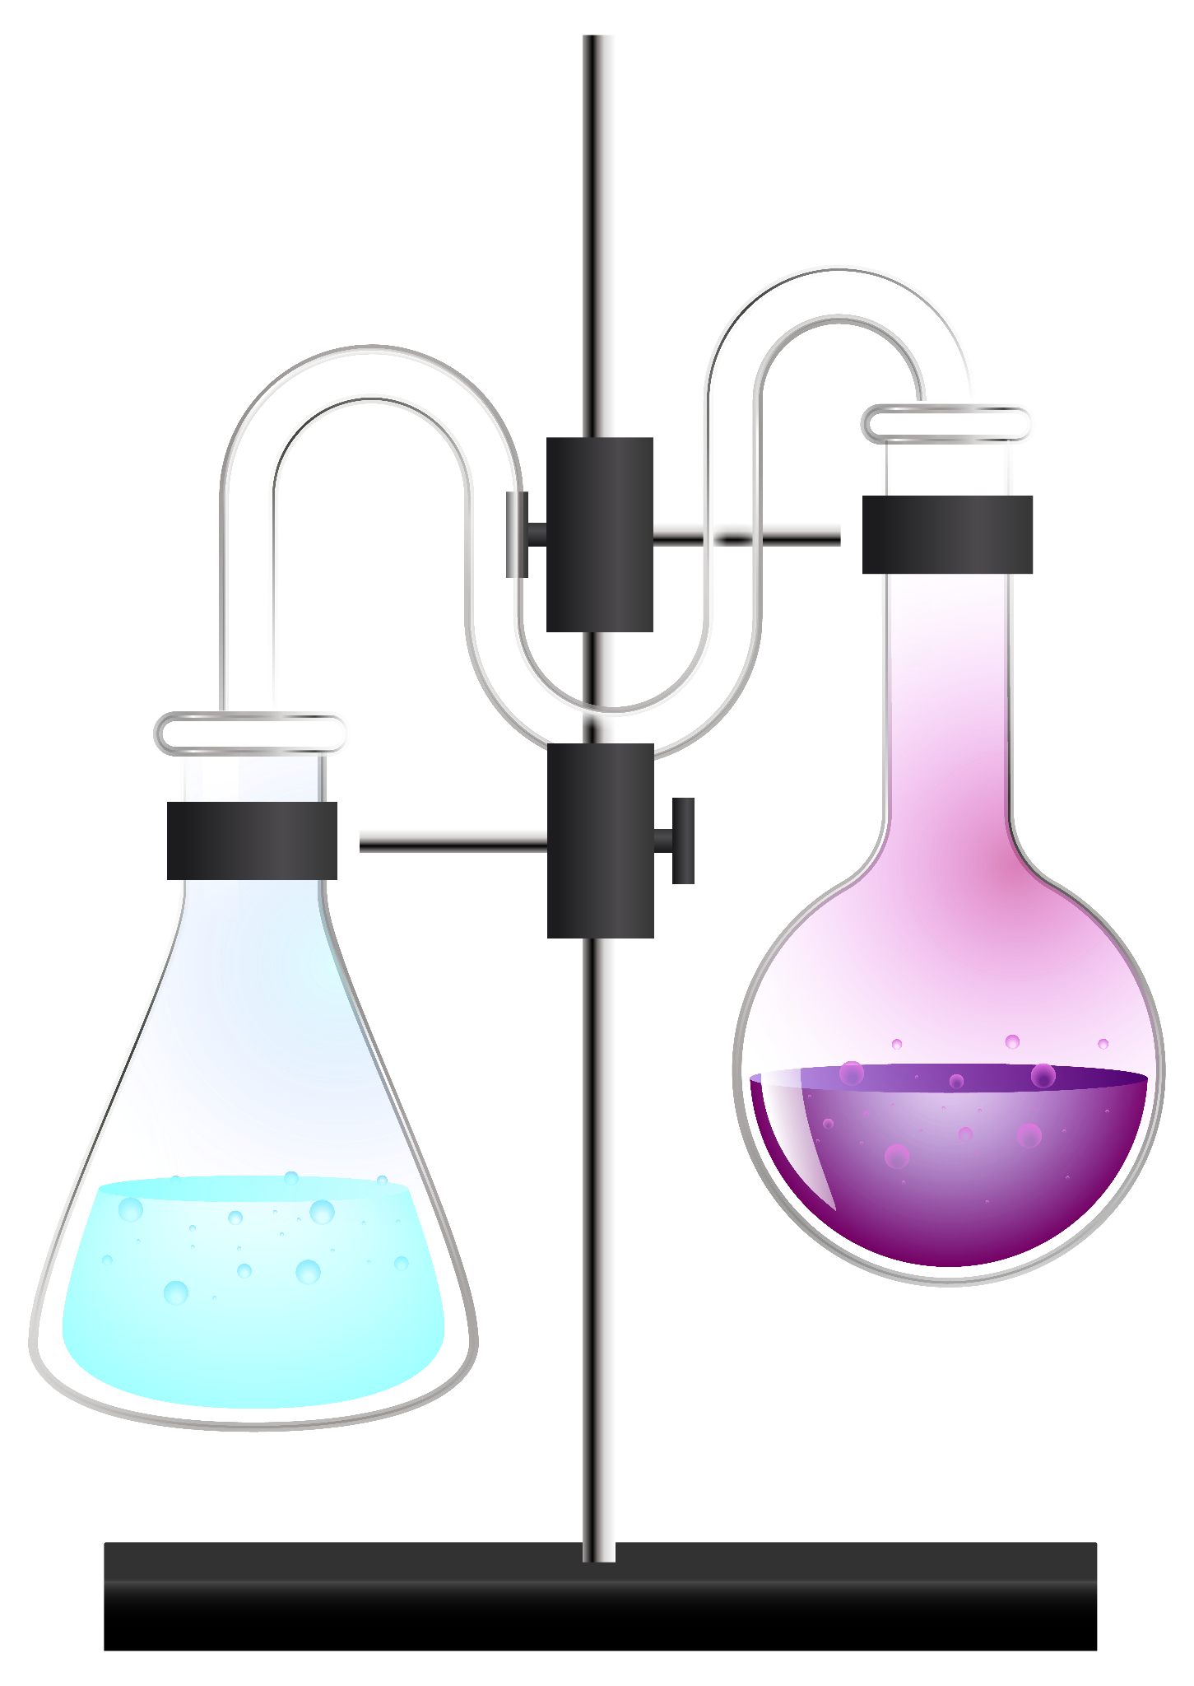
THANK YOU

